Slide 1

Introduction to Web Scraping

Slide 2
What is Webscraping?
Webscraping is the process of extracting information from webpages.
In this sense, it is an alternative for using an API to get information.
What is needed for webscraping?
Basic understanding of HTML, CSS and JS tags
A way to send requests to webpages to get their HTML code
A way to use the tags to extract relevant information

Slide 3
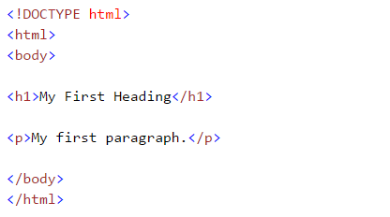
Simple HTML code

Slide 4
Common HTML Tags
div - indicates a division, or area, of the page.
b - bolds any text inside.
i - italicizes any text inside.
Table - creates a table.
form - creates an input form.
a - creates a link
href - location of link
For full list of tags: https://developer.mozilla.org/en-US/docs/Web/HTML/Element

Slide 5
Request Methods
Method | CRUD Operation
GET | Read/Retrieve
POST | Create
PUT | Update/Replace
DELETE | Remove
PATCH | Partial Update/Replace

Slide 6
Beautiful Soup: Using HTML tags
Python library that provides ways of navigating, searching, and modifying the parse tree of HTML tags.
Basically, Beautiful Soup allows you to access the HTML or CSS tags where the information you want is held. For example, if you want to extract tabular data, we would use the <table> tag.

